Slide 1
SALESGENIE
CRM Integration & Synchronization
Backend Development using FastAPI
Salesforce & Zoho CRM Integration
Lead Mapping & Synchronization
01

Slide 2
SALESGENIE — CRM INTEGRATION
Objective
1
Integrate SalesGenie lead data with CRM platforms such as Salesforce and Zoho
DATA FLOW
SalesGenie
2
Convert SalesGenie lead data into CRM-specific formats
FastAPI
3
Provide APIs for CRM synchronization
Maintain synchronization history through sync logs
CRM Mapping
4
5
Provide a backend foundation that can later be connected to actual CRM APIs
Salesforce
Zoho
02

Slide 3
BACKEND DEVELOPMENT
CRM Integration API
Developed FastAPI endpoints for CRM operations
Lead synchronization endpoint
Retrieve CRM synchronization history
Update synchronization records
Delete synchronization records
Uses the existing SalesGenie database and Lead model
POST
/crm/sync/{lead_id}
GET
/crm/{lead_id}
PUT
/crm/update/{sync_id}
DELETE
/crm/{sync_id}
Lead
FastAPI
CRM Sync
Sync Log
03

Slide 4
DATA MODELING
Salesforce & Zoho Schema Mapping
Different CRM platforms use different field names and structures. SalesGenie lead fields are transformed into CRM-specific formats.
SalesGenie Field | Salesforce | Zoho
name | FirstName / LastName | First_Name / Last_Name
company | Company | Company
email | Email | Email
phone | Phone | Phone
industry | Industry | Industry
status | Status | Lead_Status
notes | Description | Description
SalesGenie Lead
Mapping Layer
Salesforce
Zoho
04

Slide 5
API DESIGN
Mapping Preview & CRM Synchronization
Mapping Preview API
CRM Sync API
GET /crm/mapping/{lead_id}?crm=salesforce
POST /crm/sync/{lead_id}
GET /crm/mapping/{lead_id}?crm=zoho
Request example:
{
"crm_name": "salesforce"
}
Retrieves the selected lead
Applies the appropriate CRM mapping
Returns the transformed JSON
Does not modify the database
Supports Salesforce and Zoho selection
Creates a synchronization log
05

Slide 6
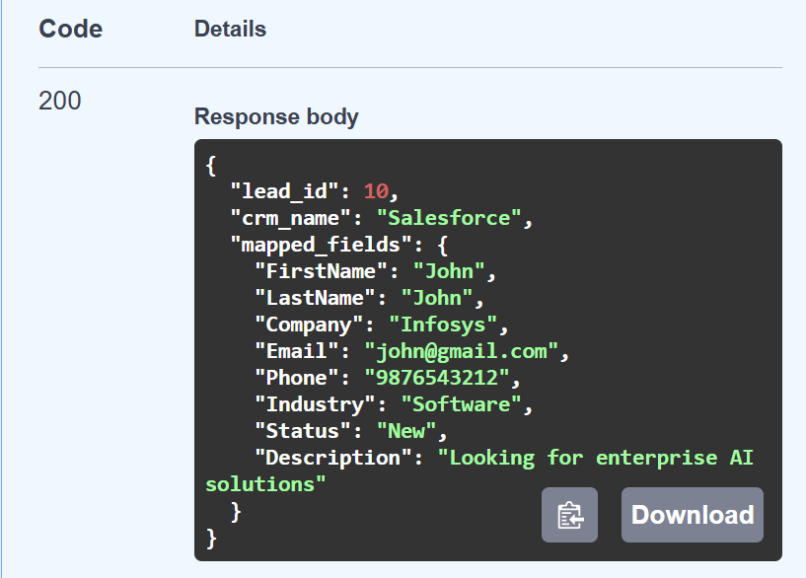
QUALITY & TRACEABILITY
Synchronization Logs & API Testing
Sync logs record
CRM name
Sync type
Sync status
Number of records synchronized
Error information
Synchronization time
Why sync logs are useful
Track synchronization history
Identify successful and failed operations
Help with debugging
Provide visibility into CRM operations
Swagger UI Screenshots
(space reserved for testing screenshots)
06

Slide 7
SUMMARY
FastAPI-based CRM integration backend implemented
Salesforce and Zoho schema mapping implemented
CRM mapping preview API implemented
CRM synchronization endpoint implemented
Synchronization log management implemented
APIs tested successfully using Swagger UI
Architecture is prepared for future integration with actual Salesforce/Zoho APIs
“SalesGenie now has a backend foundation for CRM integration, data mapping, synchronization, and synchronization tracking.”
Thank You
Questions?
07

